Slide 1
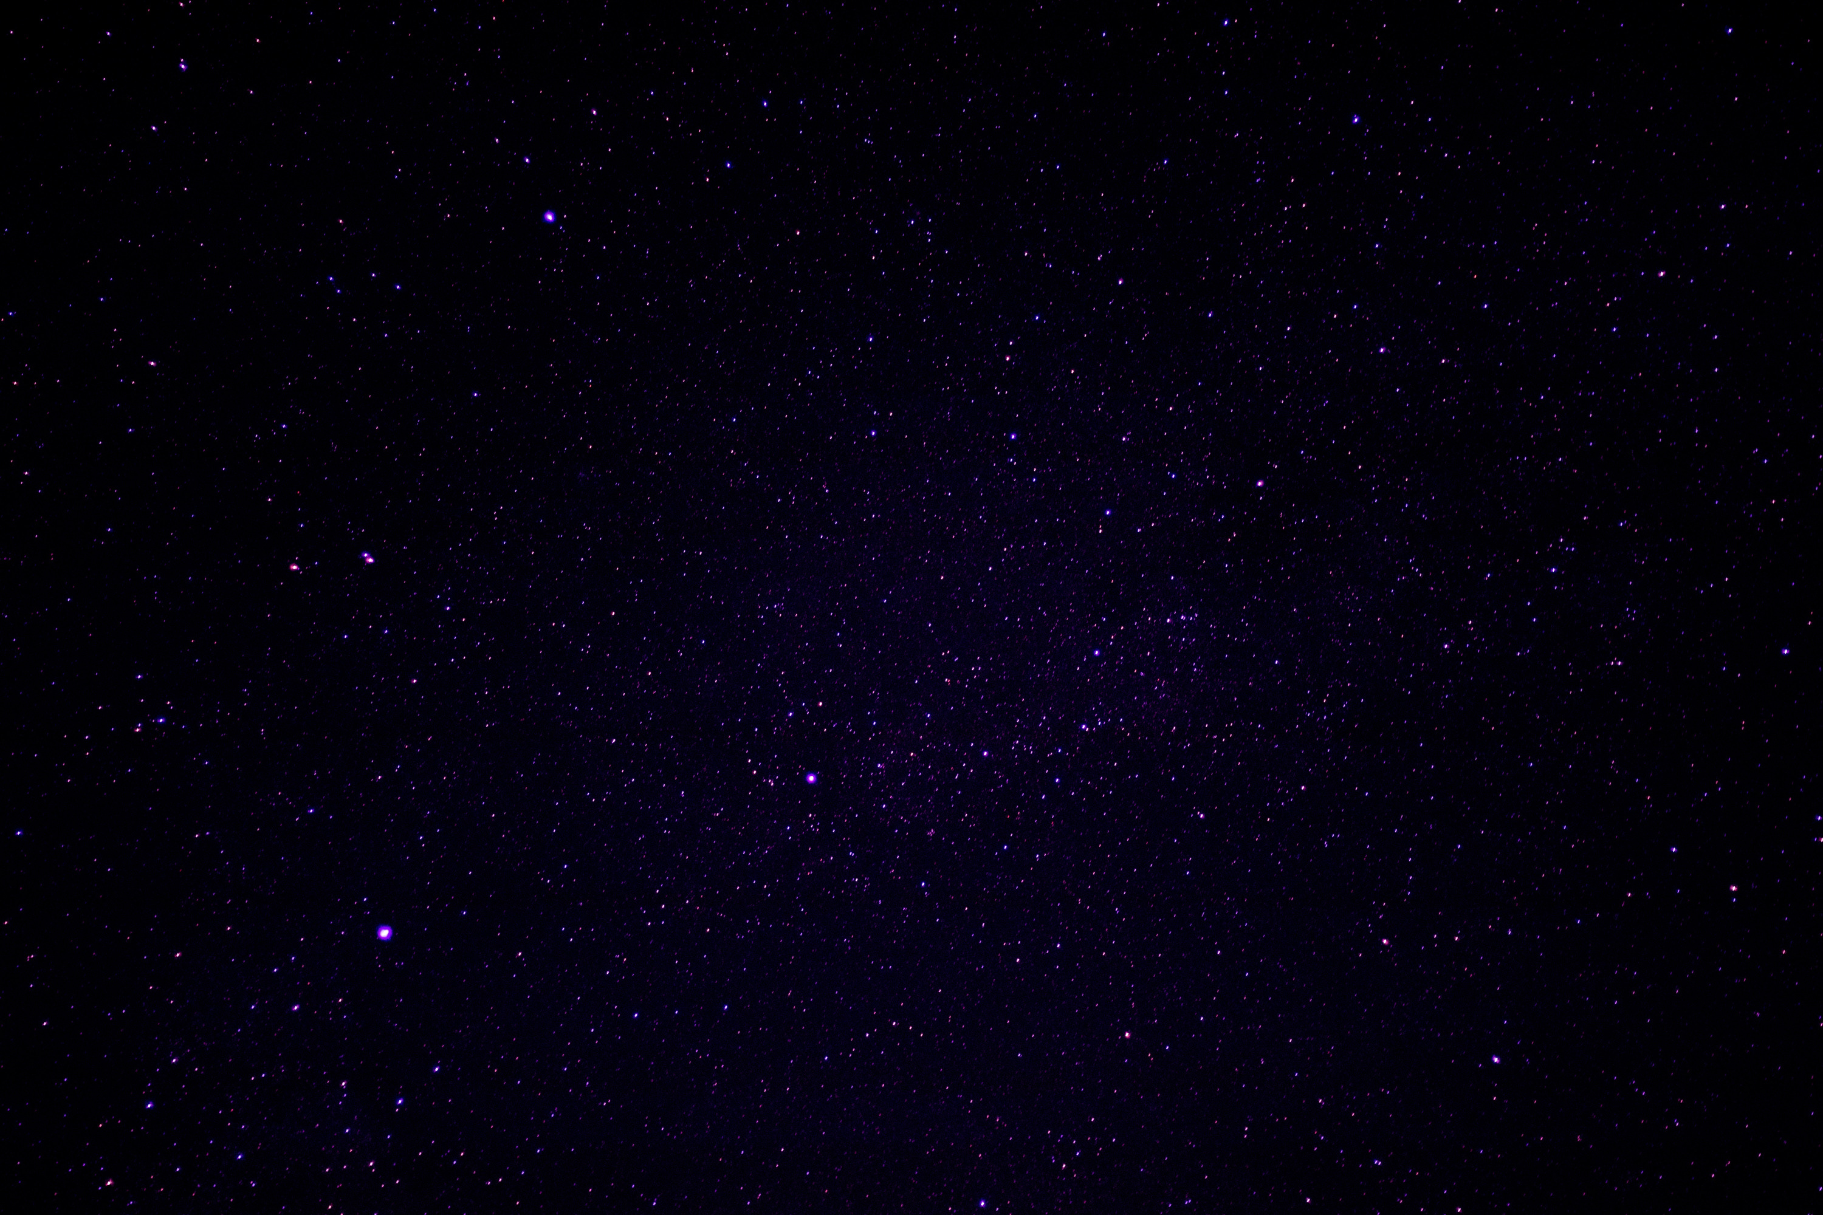

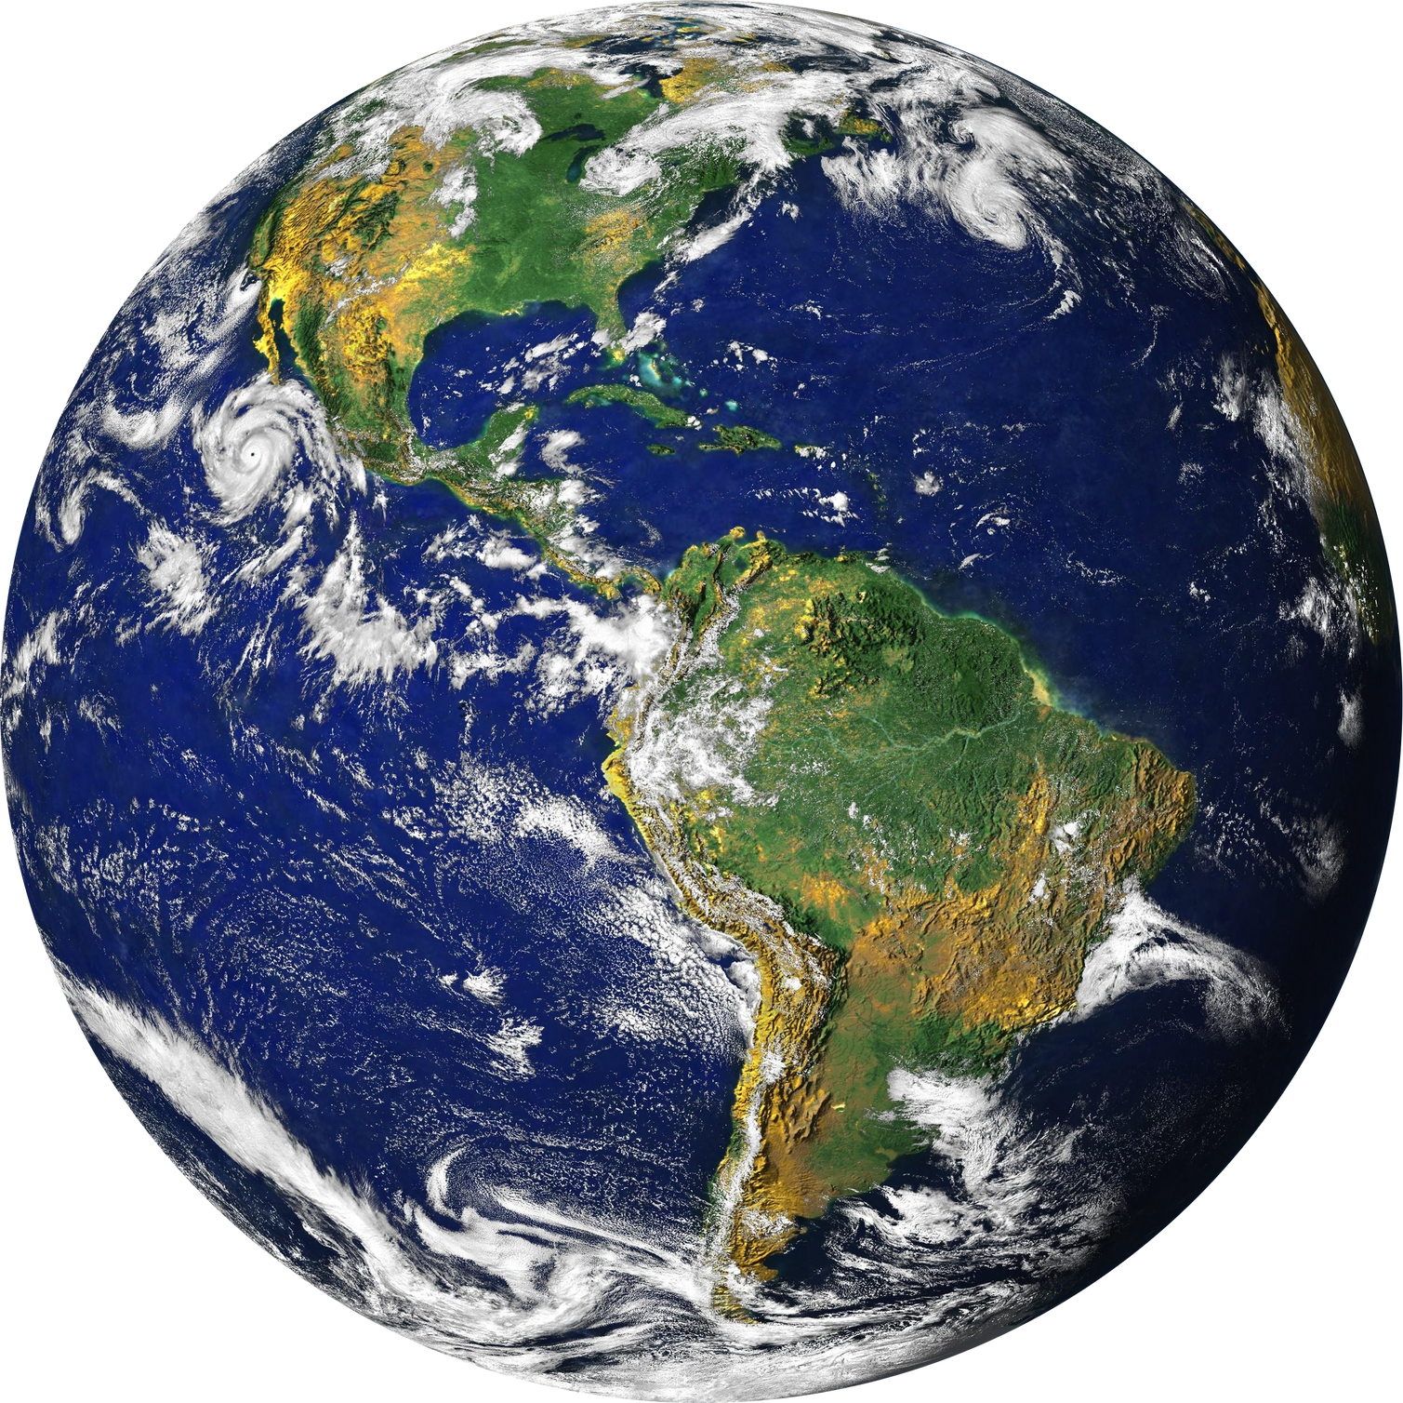
JPL-WANNABEES
STELLAR STORIES

Slide 2
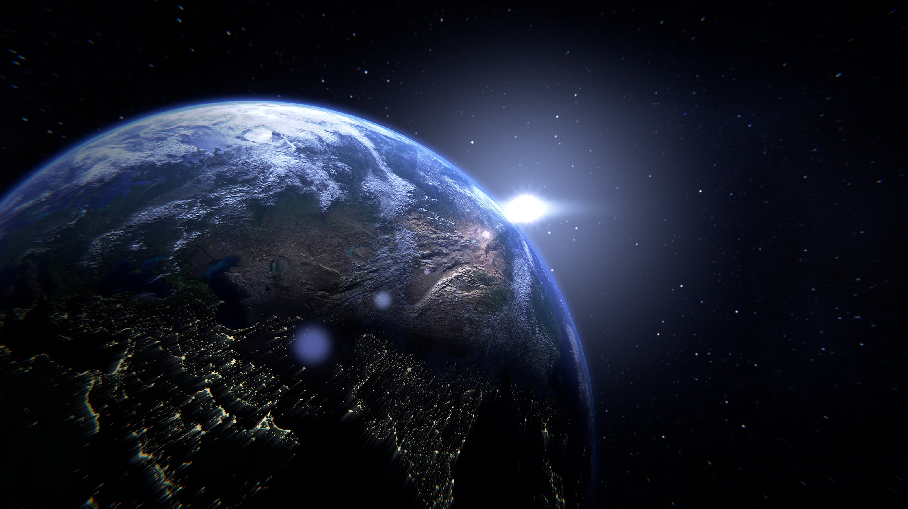
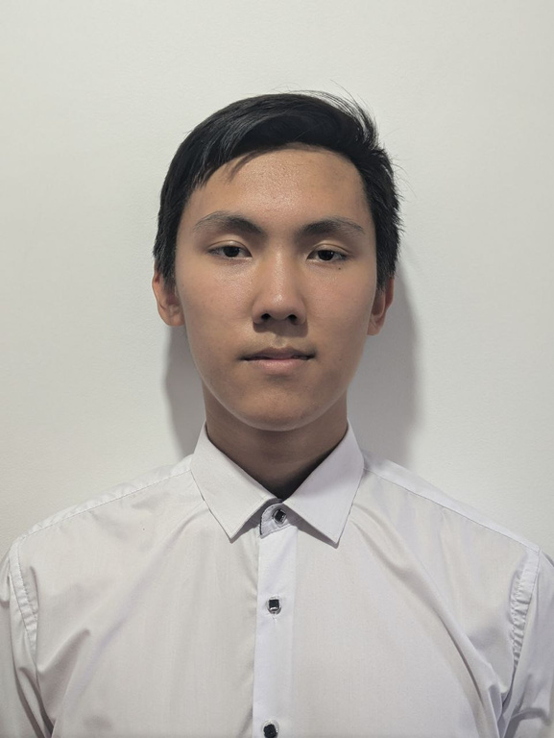
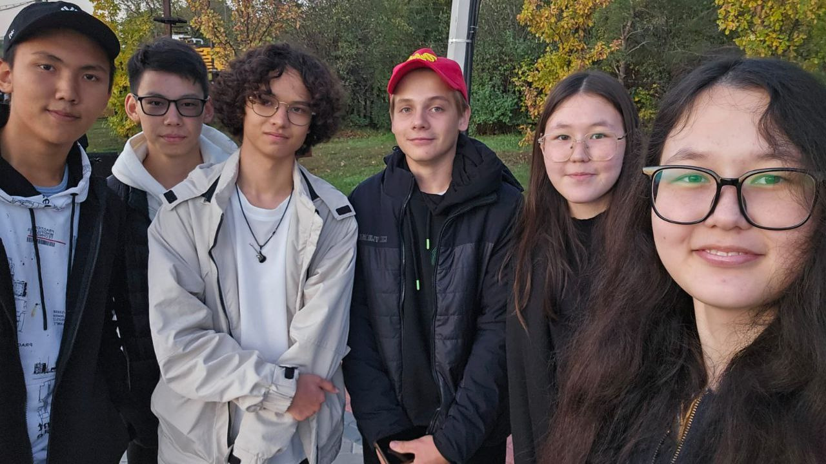

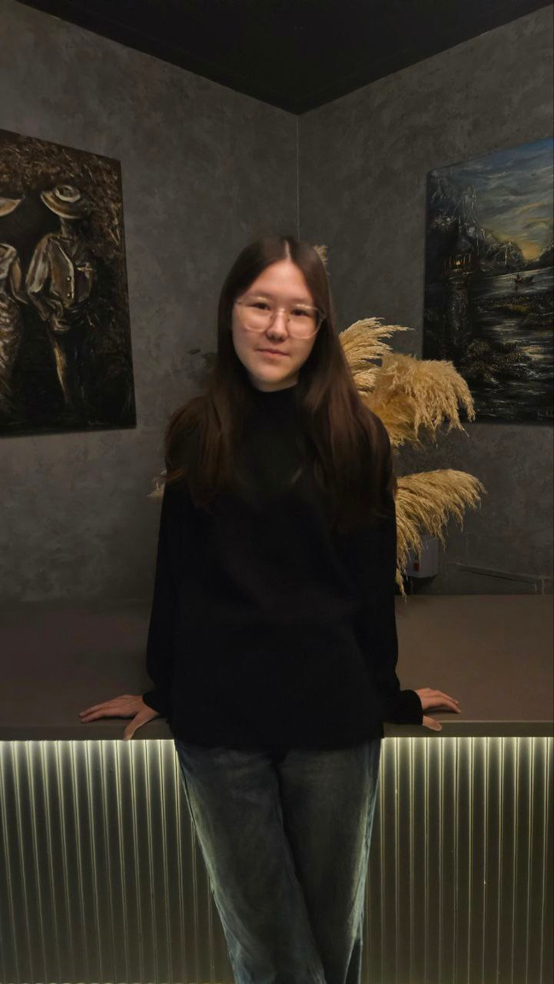
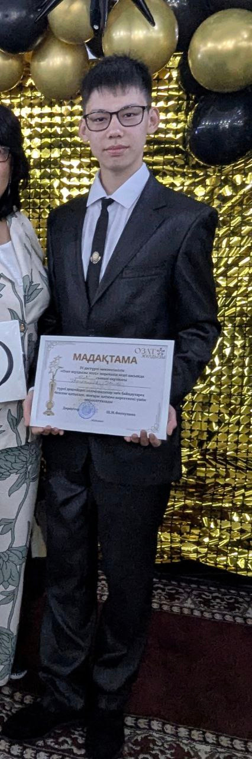
TEAM MEMBERS
MANSUR
NURTAS
YASMIN
AILIN
ARSEN
programmer
programmer
UI/UX engineer
concept artist
designer
screenwriter

Slide 3
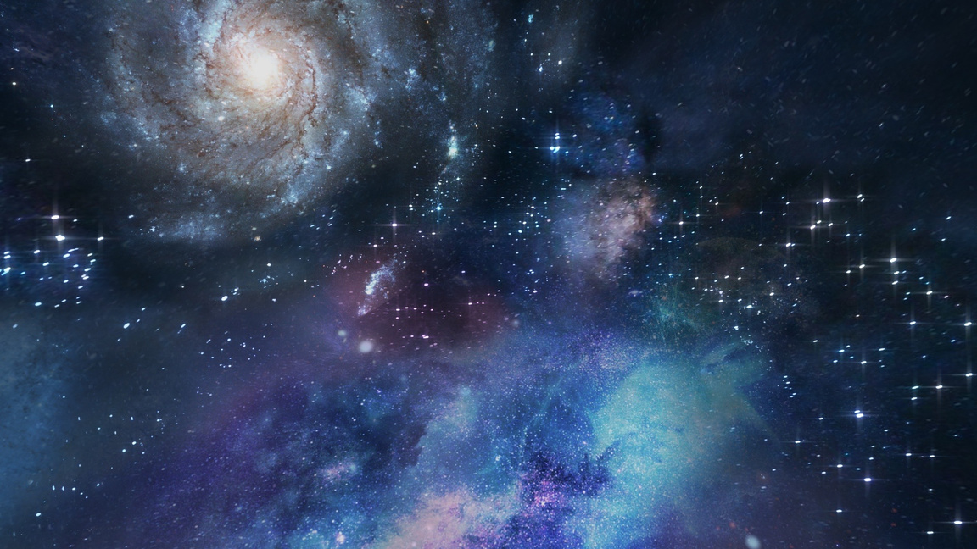
OUR WORK
The goal and idea of our project is to create a website that shares information about solar flares and their consequences through engaging games. The games are presented from the perspectives of those affected by solar flares — from the crew of a space station to ordinary mountaineers climbing a mountain. In this way, we aim to show how powerful their impact can be.

Slide 4
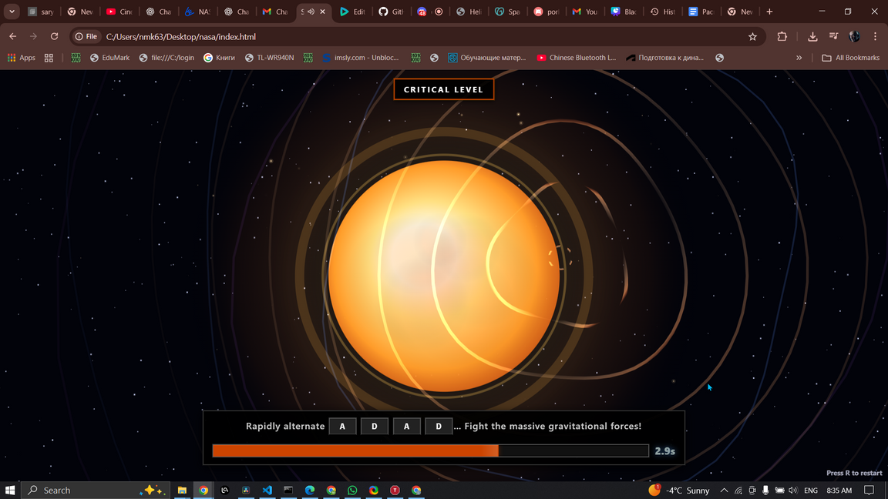
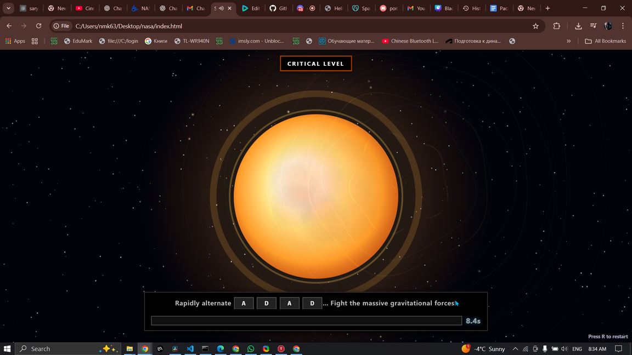
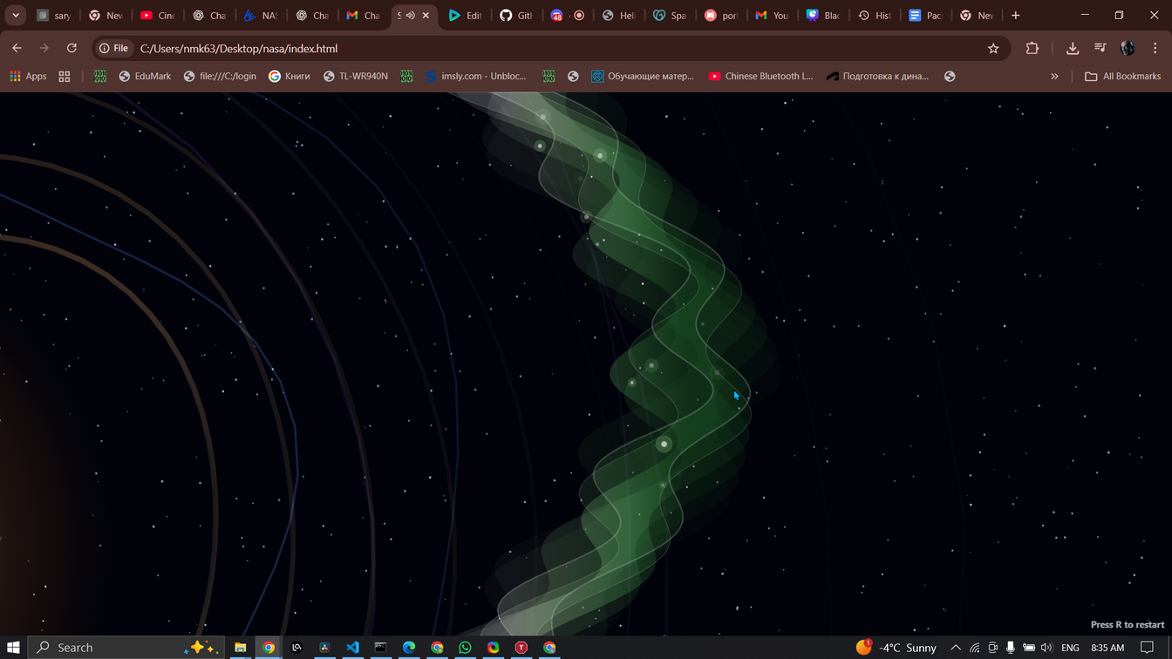
“THE BIRTH OF A FLARE”
in this section the user is met with a Quick-Time-Event,
there they must rapidly press the A and D keys to cause a solar flare.
This part intents to demonstrate the build-up of a potential energy in the magnetic field
Sources: https://science.nasa.gov/sun/solar-storms-and-flares/

Slide 5
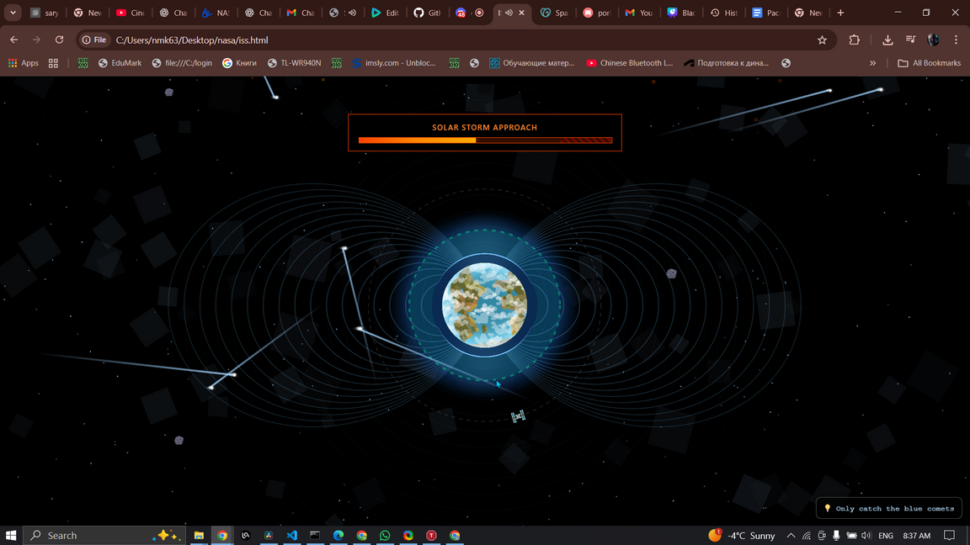
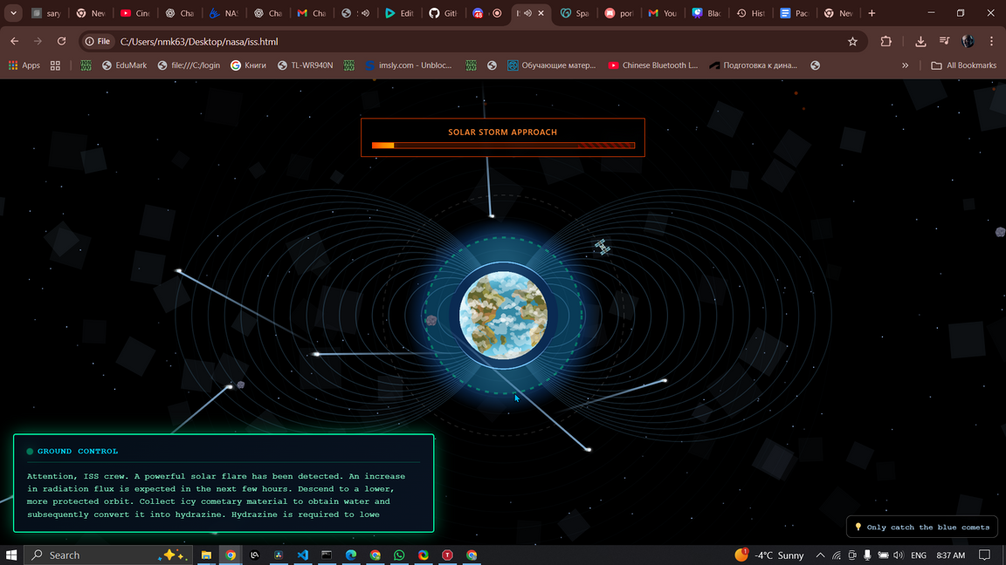
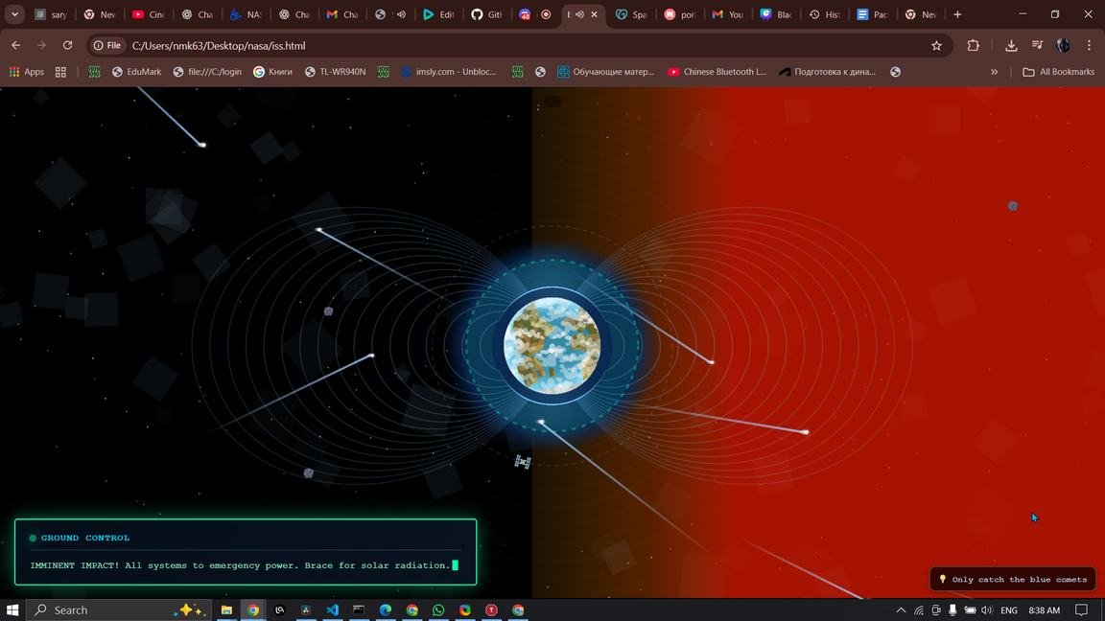
“ORBITAL MANOEUVRE”
Here the is prompted to lower
the station's orbit into a
safer altitude within our planet's magnetic field..
They do that by catching the icy comets and extracting
hydrazine needed to perform the maneuver
Sources: https://svs.gsfc.nasa.gov/12640/

Slide 6
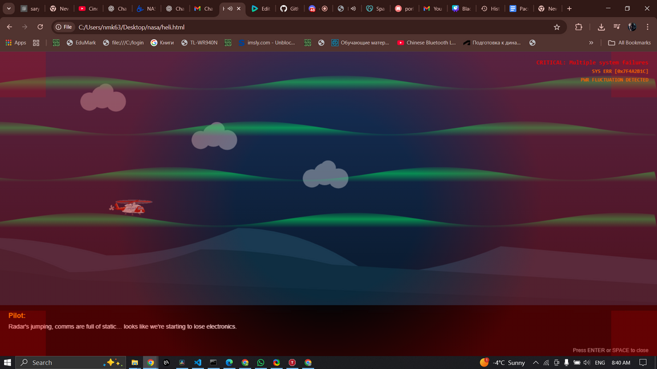
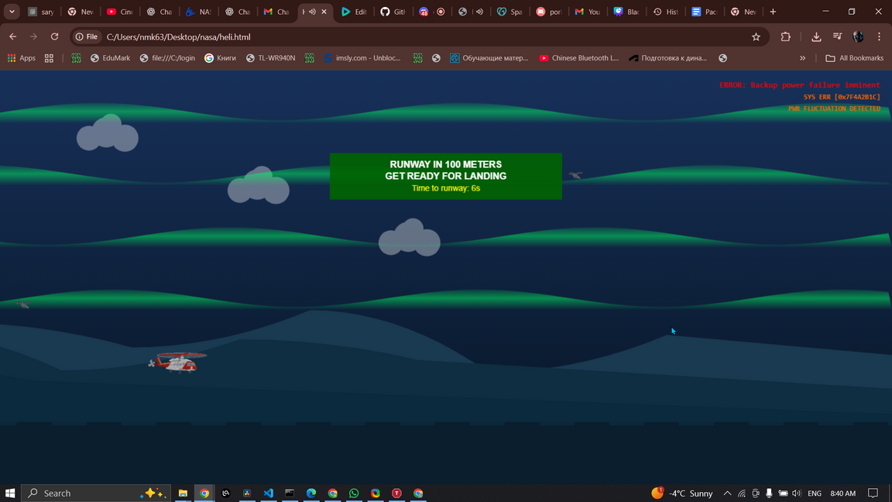
“SINGLE EVENT UPSET”
In the last minigame, we play as polar expeditioners on a mission. Suddenly, we are caught in an X-class geomagnetic storm and experience problems with avionics due to single-event upsets, meanwhile Aurora Borealis is visible in the sky. The goal is to land safely and evade birds through the static on the screen.

Slide 7
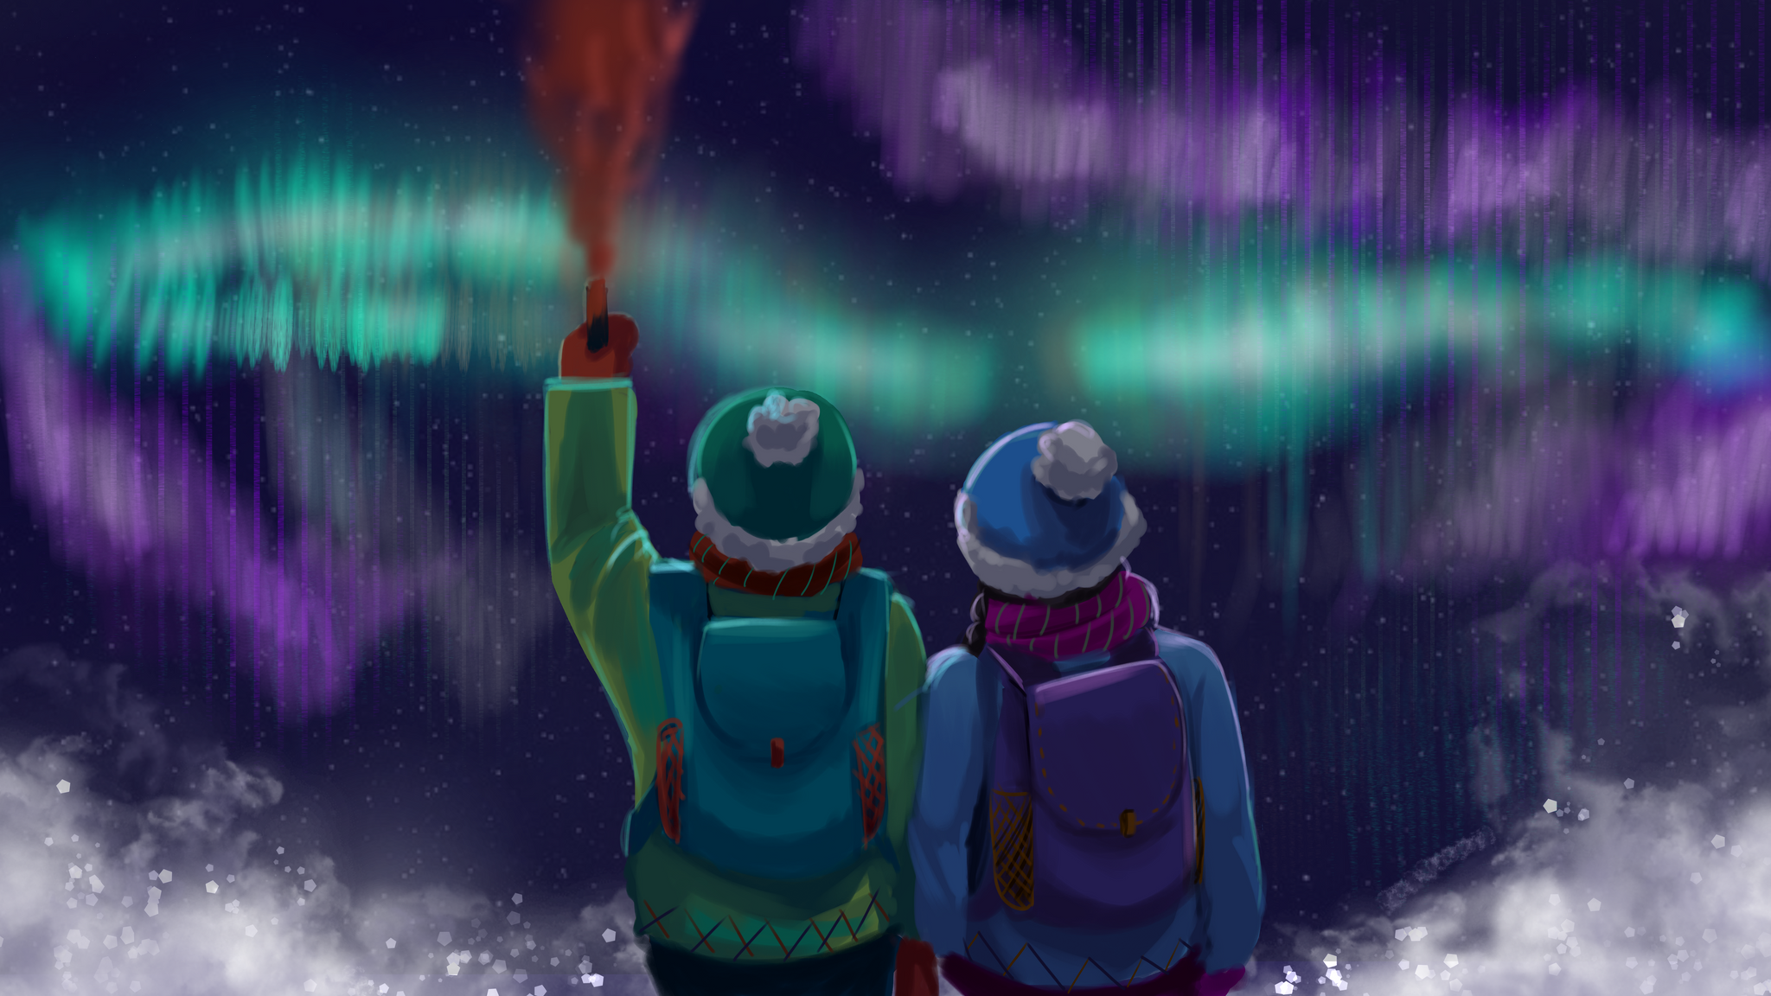
“GAZING THE SKY”
ARTWORK BY YASMIN
“THE ENDING SCENE”

